Slide 1
WNR First Spring Meeting
January 22, 2016

Slide 2
Agenda
Relooking at BLE
Data Rate Re-analysis
Compression Requirements
Energy/Power Consumption
Compression
Analog Front-End and SPI
Requirement Variable Graphs
Demos

Slide 3
BLE Data Rate Analysis
Require 128 kbps per probe
16 channels * 1000 samples/channel * 8 bit/sample
Nordic nrf52
Capable of sending 6 packets/connection interval; each packet is 20 bytes
Smallest connection interval is 7.5 ms
6 packets / connection * (1000 / 7.5) connection/sec * 20 bytes / packet
Total = 128 kbps
Still Require Some compression, even if just a little (x2)

Slide 4
BLE Data Rate Current State of Nordic NRF52
6 packets/interval
20 bytes/packet
6 packets / connection * (1000 / 7.5) connection/sec * 20 bytes / packet
~128 kbps

Slide 5
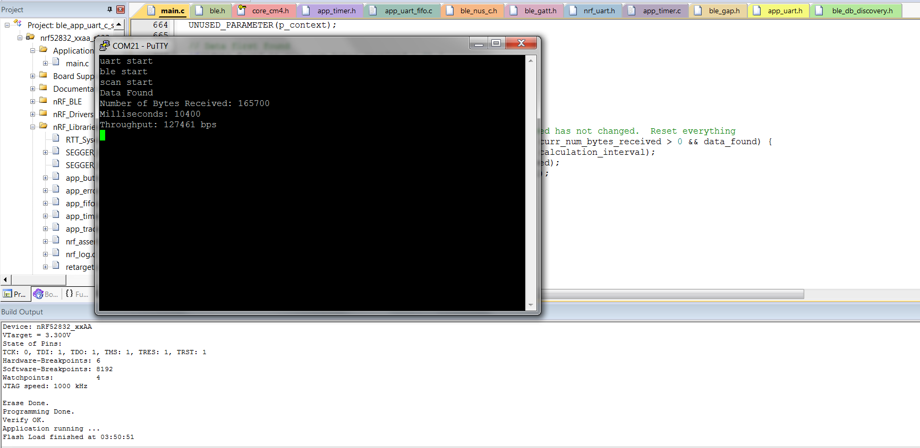

Slide 6
Compression Requirements
Assume 20% additional overhead
103 kbps is the expected raw data rate
Compression Ratio Required for throughput:
100% - (103kbps / 128kbps) = 19.53%
Compression Ratio Required for bandwidth:
1024Mbps / 2048Mbps = 50%

Slide 7
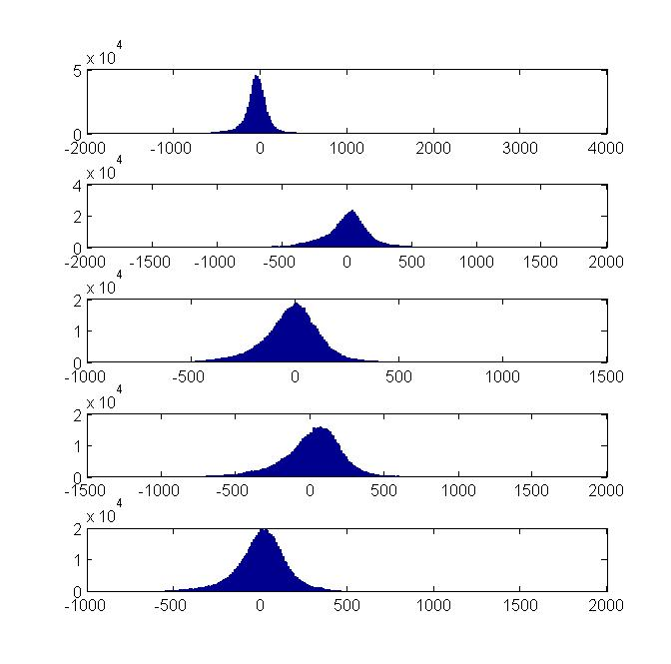
Compression Method
Convert double to uint8
Quantize
Convert 2’s complement to uint
Manually truncate parts of the data
Run compression in cmd line

Slide 8
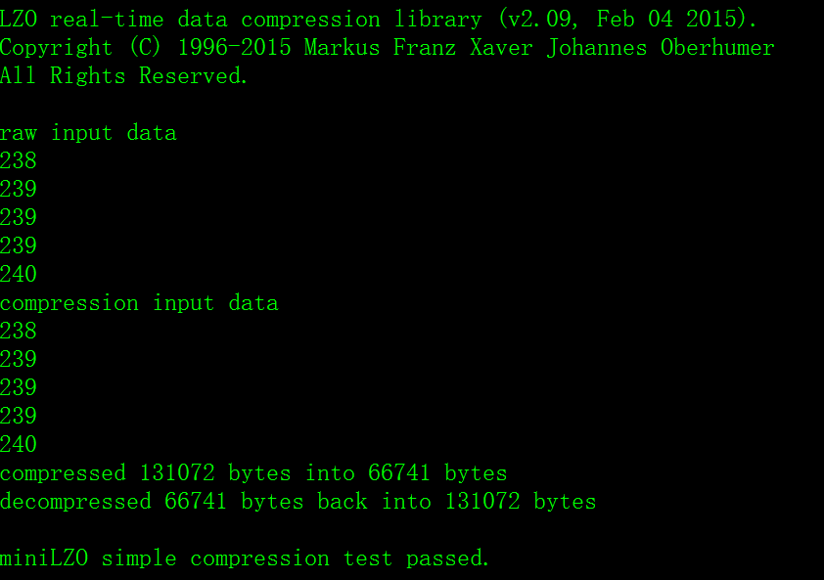
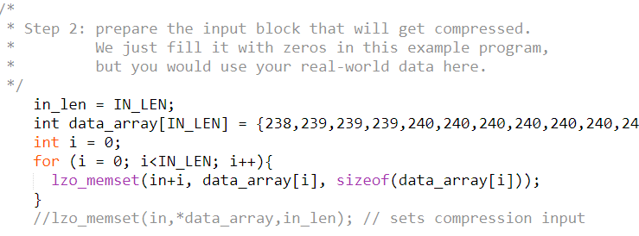
Compression results

Slide 9
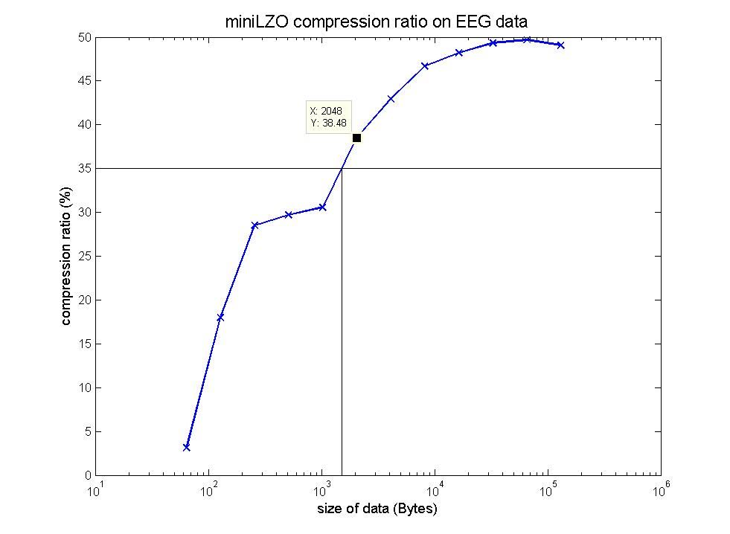
Compression Results

Slide 10
Power Feasibility: AFE - Intan RHD2000
Amplifier:
Baseline = 200 uA
7.6 uA/kHz upper cutoff frequency/channel
ADC:
Baseline = 510 uA
2.14 uA/kHz/channel
Supply Voltage and Auxiliary Inputs:
40 uA

Slide 11
Power Feasibility: AFE - Intan RHD2000
Amplifier Current:
200 uA + 16 * 1* 7.6 uA/Khz/channel = 321.6 uA
ADC Current:
510 uA + 16 * 1 * 2.14 uA/kHz/channel = 544.24 uA
Supply Voltage and Auxiliary Inputs:
40 uA
Total Power Consumption with 3.3V Supply
3.3 * (321.6 + 544.24 + 40) = 2.99 mW
To run for 24 hours: (321.6 + 544.24 + 40) uA * 24 hours = 21.74 mAh

Slide 12
Power Feasibility: BLE Transmission - NRF52
Transmit at +0 dBm:
5.5 mA
Power Consumption with 3.3 V power supply: 3.3V * 5.5 mA = 18.15 mW
To run for 24 hours: 5.5 mA * 24 hours = 132 mAh

Slide 13
Power Feasibility: Total System
AFE: 21.74 mAh
BLE at +0 dBm: 132 mAh
Total Power Consumption = 21.74 + 132 = 153.74 mAh
Using the Zinc-Air p13 battery (300 mAh) is enough to power both types of transmission with enough power for compression and other processing
Zinc Air P13 Battery
300mAh @ 1.45V
7.9mm x 5.4mm (d x h)

Slide 14
Power Feasibility: Battery
Zinc Air p13:
diameter: 7.9 mm
height: 5.4 mm
Typical capacity 300 mAh

Slide 15
SPI & AFE
Finished learning and configuring the SPI protocol on board.
Start testing Intan chip.

Slide 16
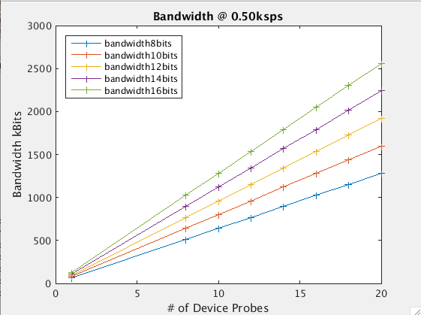

Slide 17
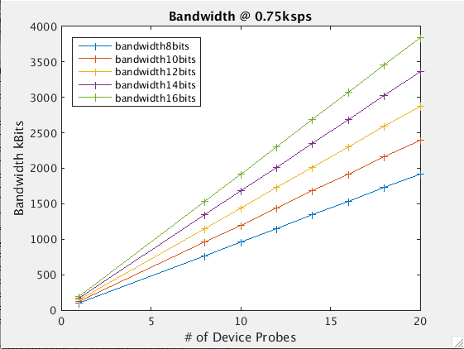

Slide 18


Slide 19
Timeline for the semester
2/22 prototype review
Complete primary prototype development and testing
Start circuit design and manufacturing
4/14 Design Showcase
Secondary prototype : 2D circuit board layout
Tertiary prototype: 3D tiered circuit board design
Characterization of design (BRC?)

